Slide 1
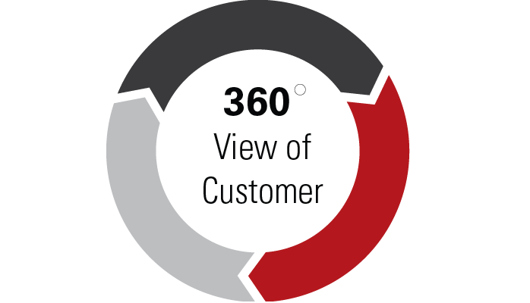
Customer 360
Most awaited project in Banking and Finance, Retail and Telecom

Slide 2
Agenda
Things you will learn
Customer 360 introduction
Key points
Architecture
Lab

Slide 3
Things you will learn
After completion of this project, you will learn the following:
Customer 360
Customer 360 Architecture
End to end implementation
Technologies: MySQL, sqoop, pig, Hbase, Hive

Slide 4
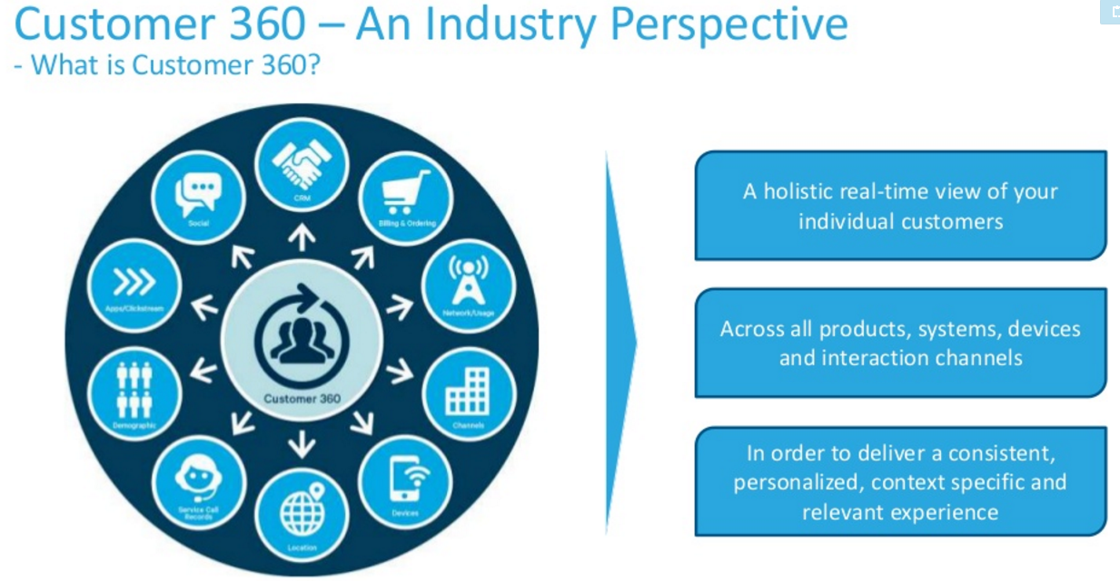
Reference: cloudera

Slide 5
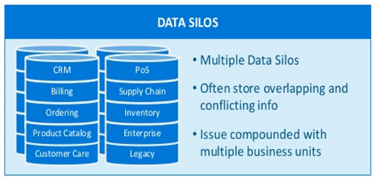
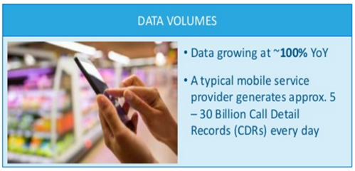
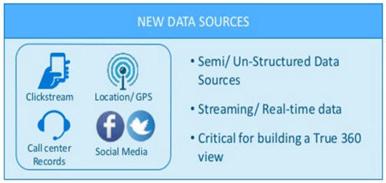
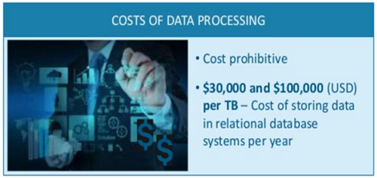
Key challenges in Driving a Customer 360
Reference: cloudera

Slide 6
Reference for Customer 360
http://www.slideshare.net/cloudera/using-big-data-to-drive-customer-360

Slide 7
What is customer 360
Customer 360 refers to summarized information related to customer, at every digital touch point, which describes the behavior of customer, and predicts what can happen with him in future.
It can be thought on mega table, which is holding information of all products a customer holds, summary of all customers transactions, demographic features, CRM information.

Slide 8
Why;Understand Your Customers
Improve the entire customer lifecycle with a customer 360-degree profile.
Any marketing team or any other team dealing with customers must leverage technology to:
collect and analyze customer data
execute successful omni-channel campaigns
understand the customer lifecycle
influence buyers in a congested market.

Slide 9
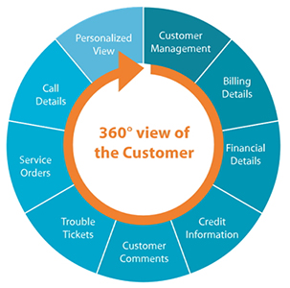
Possible data sources

Slide 10

Use case1; Customer Acquisition & Retention
How to acquire a new customer and how to retain existing customers is a big time challenge for any marketing team.
Now with customer 360, they know the DNA of customer, there by plan accordingly.
Especially in telecom sector, this is a big challenge.

Slide 11

Use case2: Next best offer
Whom to offer what is a big question?
Especially in retail sector, identifying loyal customers and offering them products based on previous transactions is a bigger challenge.
Having customer DNA will make it much simpler.

Slide 12

Use case3: Customer satisfaction
Email sent by a customer, needs an immediate response.
It’s important that organizations collect every interaction in order to identify leading indicators of unhappy customers, keep their existing customers, and improve net promoter scores.

Slide 13

Up sell and cross sell recommendations
Identifying similar customers is on the top priority for all the industries, as it can solve upsell, cross sell, product recommendation and many other problems.
To identify similar customers, one should have all possible information of customers, summarized and store digitally.
Customer 360 can do that.

Slide 14
Why hadoop for customer 360?
Existing systems are costly
Are not scalable
Vendor locked
Slow in processing

Slide 15
Key Notes
To demonstrate this case study, we have created data sets and designed dataflow architectures.
Students will get to know how to implement customer 360 industrial case study, which is the most needed technology for many sectors.
This will improve your profile.

Slide 16





Architecture
Demographics
Credit, debit Card trx
Loan, current, deposit
Data Sources
Load
Transform
Store
Ingestion
MySQL -> Sqoop -> HDFS
Extract Load Transform
PIG
Storage
Hbase NoSQL
Access to Users Hive

Slide 17
Step1: Understanding data
In datasets folder, six datasets are provided:
Credit card: Credit card account details.
Credit card trx: Credit card trx details.
Demographics: Customer demographic details.
Deposit: Deposit account details.
Loan: Loan account details.
Savings: Savings account details.
Refer to datasets folder.

Slide 18
Step2: Load data to MySQL
To replicate the exact business scenario, data will be first ingested to MySQL.
Refer to step2.

Slide 19
Step3: Data Ingestion
Sqoop will be used to ingest data from MySQL to HDFS.
Sqoop is the most preferred tool for data ingestion.
Refer to:

Slide 20
Step4: Customer 360 Mega Table; HBase
Create a table with following column families:
Demographics
Savings
Loan
Credit
Deposit
credittrxsummary

Slide 21
Step5: ELT with Pig
Pig is the most preferred tool for ELT. It has many capabilities:
Can create complex projections.
Can store output in any point of data flow.
Easy to understand
Suites well for data flow
Refer to:

Slide 22
Now check hbase
Now in Hbase, for each customer, all possible information from all different products are at one place.
Now how would you provide access to different teams??

Slide 23
Providing access; Hive
Now different teams need different data. Reception office should have access to only account information. Marketing team needs customer wallet data. Like this, different teams need different data, to make decisions.
Using hive, map external tables to required columns in Hbase.
Refer:

Slide 24
Conclusion
Customer 360 is the most needed project in many banking, telecom and retail sectors.
With hadoop, entire load on traditional systems can be transferred to hadoop, and there by cost cuttings.

